Slide 1
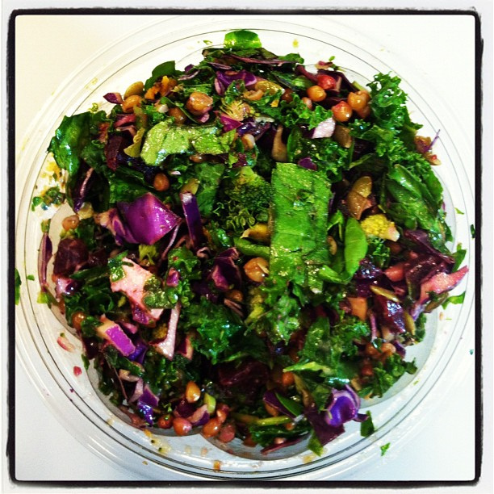
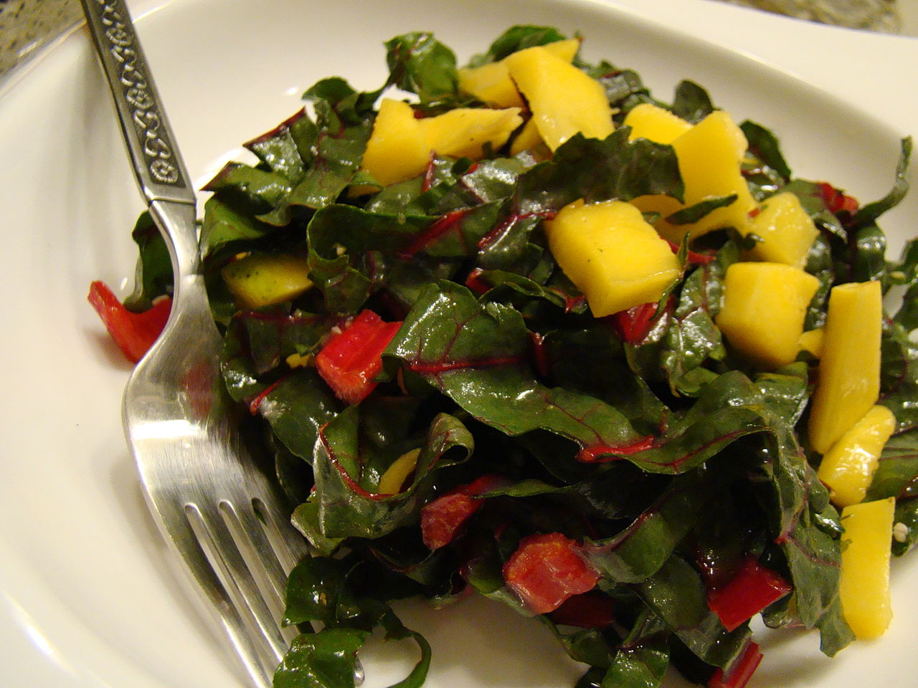
Superfood Blind Taste Testing Game

Slide 2
Directions
Select 3-4 people from your group to serve as the testers, preferably individuals without any food allergies
Your team will receive 1 point if your teammate is the first one to correctly identify the superfood
After the food is identified, we will discuss the health benefits of that particular food

Slide 3
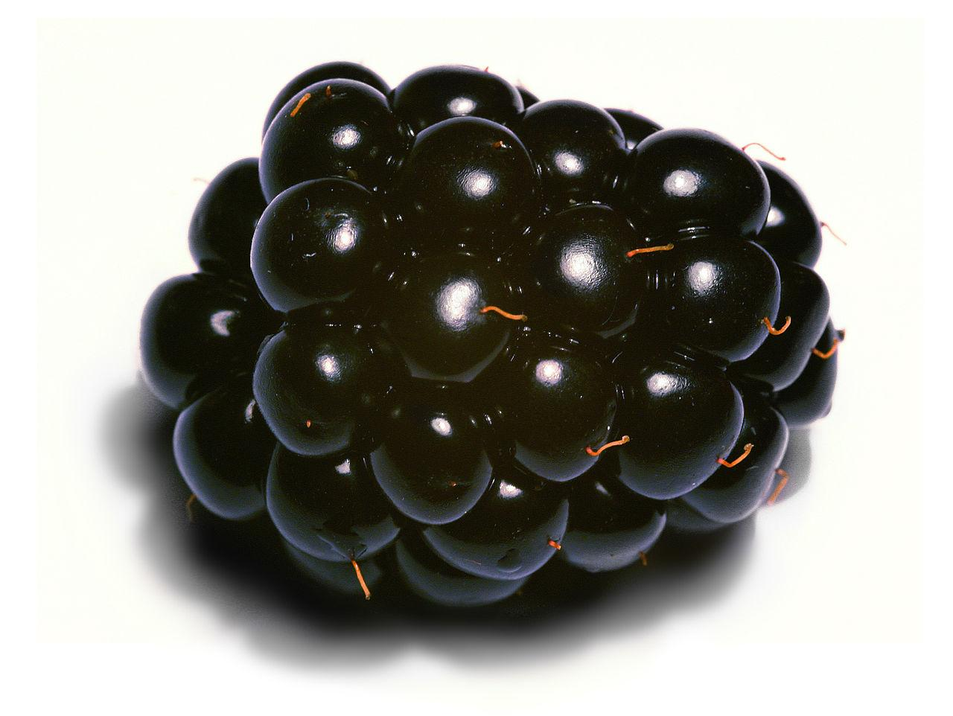
Blackberries
Possible reduction in the risk of esophageal and colon cancers
May reduce tumor growth
High phenolic compound (chemical compound) levels fight disease

Slide 4
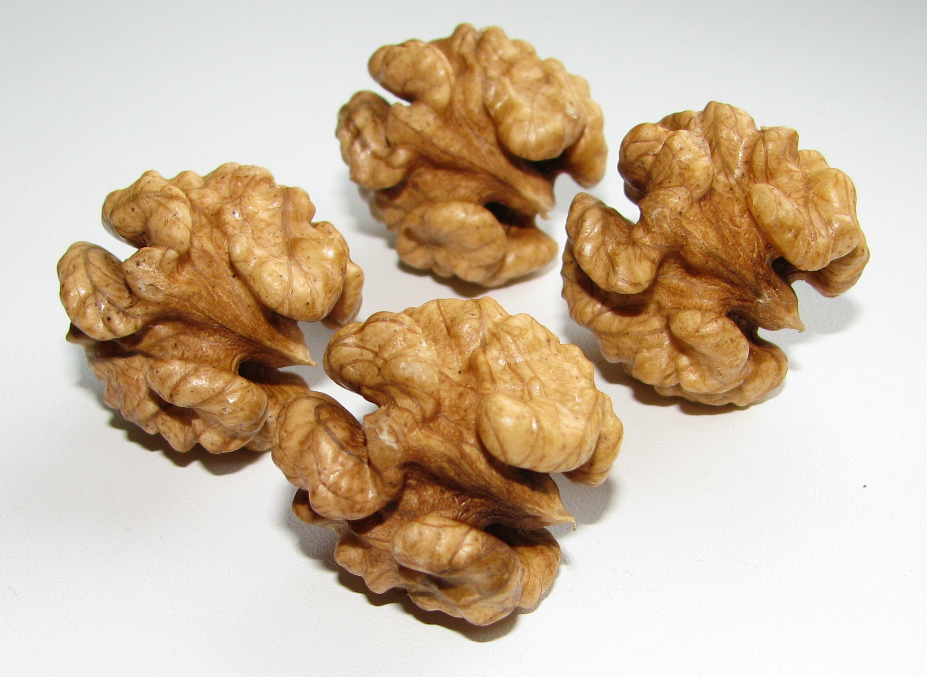
Walnuts
Lower blood pressure
Skin and membrane protection from vitamin E
Five or six nuts a day help free the body of free radicals (molecules with unpaired electrons that cause damage to cells and contribute to disease)

Slide 5
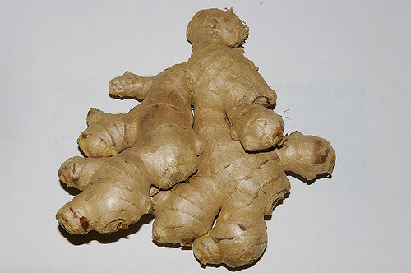
Ginger Root
Cognitive enhancer
Nausea remedy
Menstrual symptom reliever

Slide 6
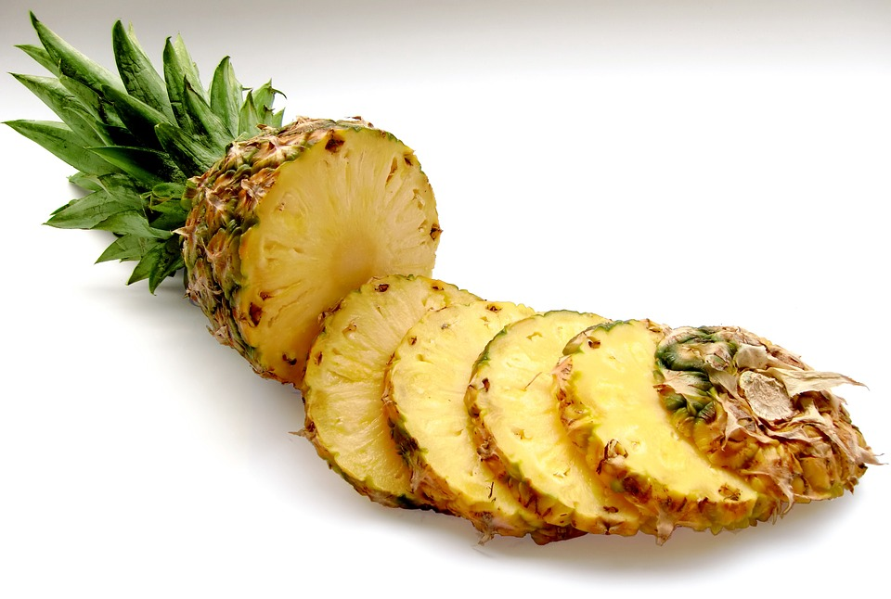
Pineapple
Increased immune functions
Lower cholesterol levels
Reduced symptoms of sore throat or gout (a form of inflammatory arthritis)

Slide 7
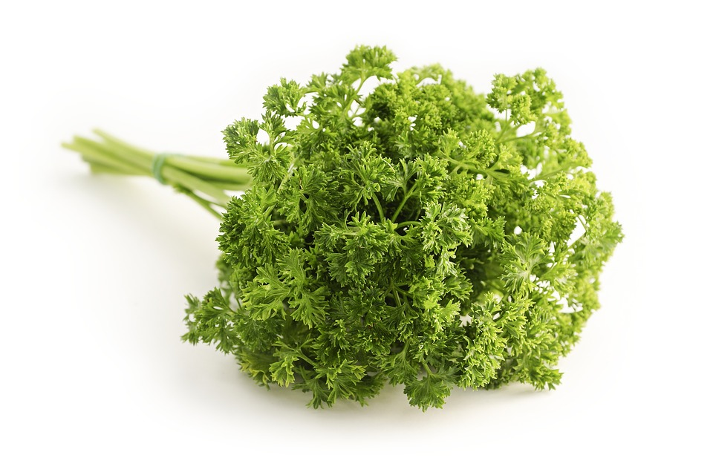
Parsley
Reduced bloating during menstruation
Reduced urinary tract, kidney, or bladder problems
Increased immune function

Slide 8
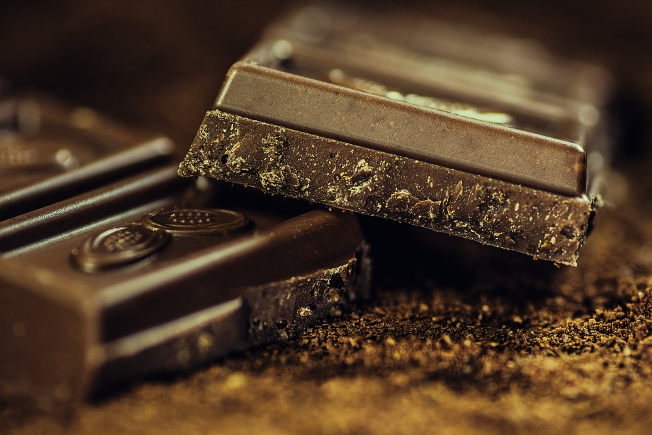
Dark Chocolate
Chances of reduced blood pressure
A lower chance of blood clots
Reduced inflammation
Improved cognitive functioning

Slide 9
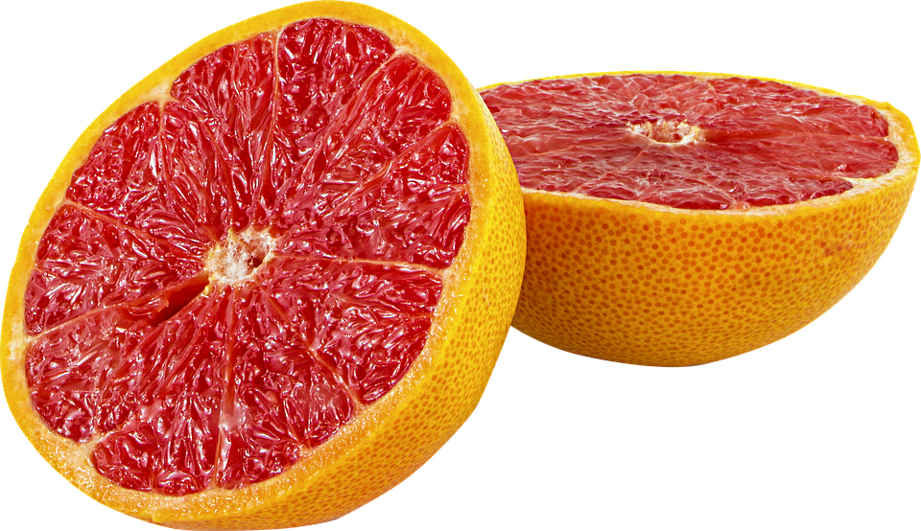
Grapefruit
Protection against Alzheimer’s disease
Detoxification of the liver
Possible prevention of breast cancer

Slide 10
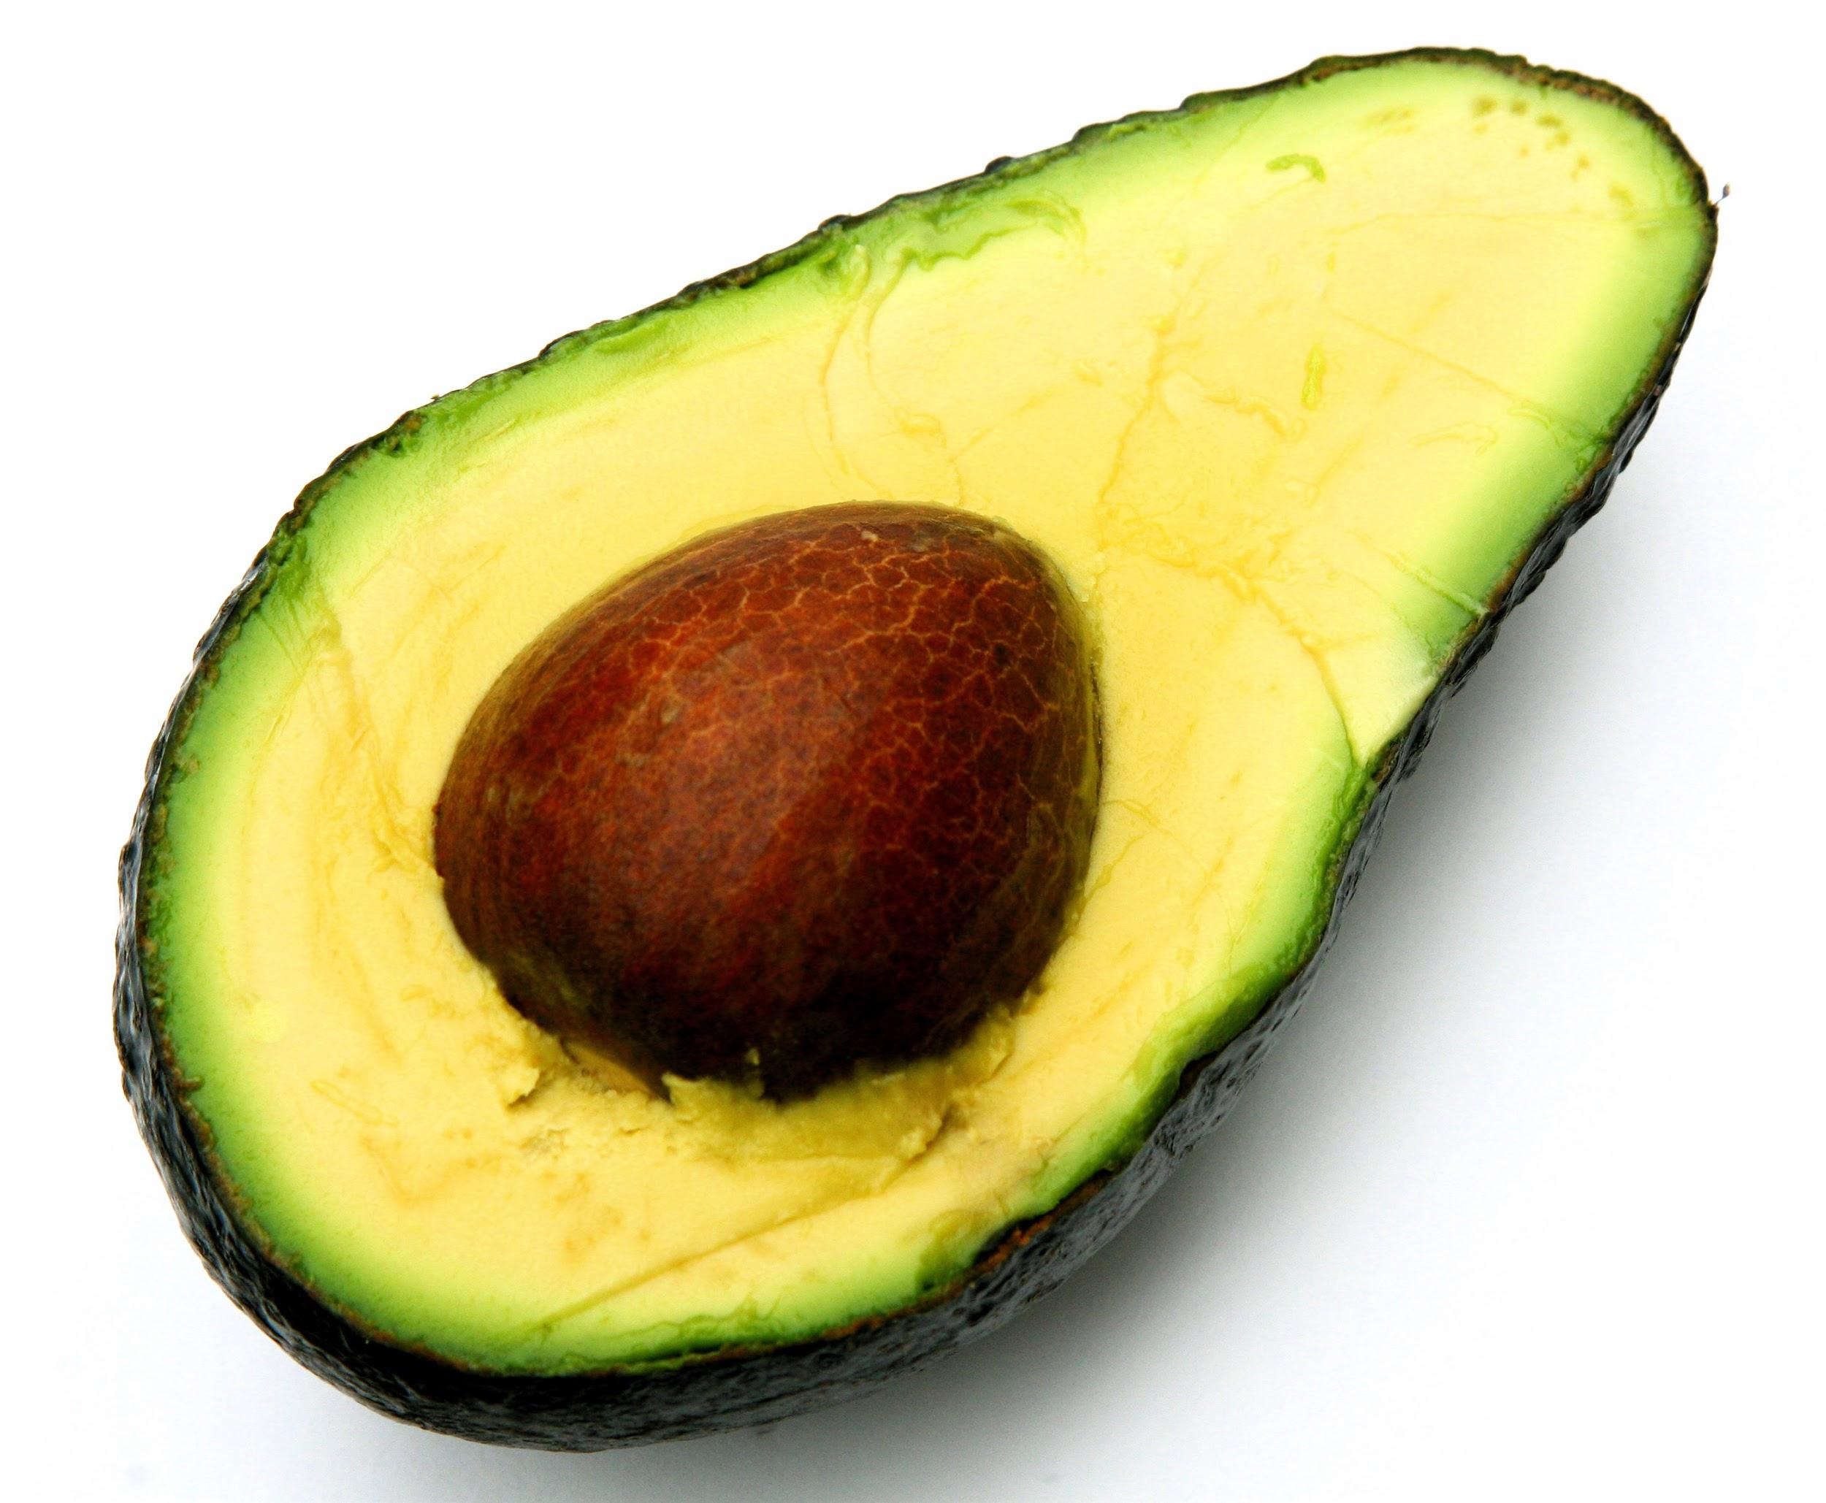
Avocado
Lower blood pressure and reduced risk for hypertension
Higher cognitive functioning
related to lower blood pressure

Slide 11
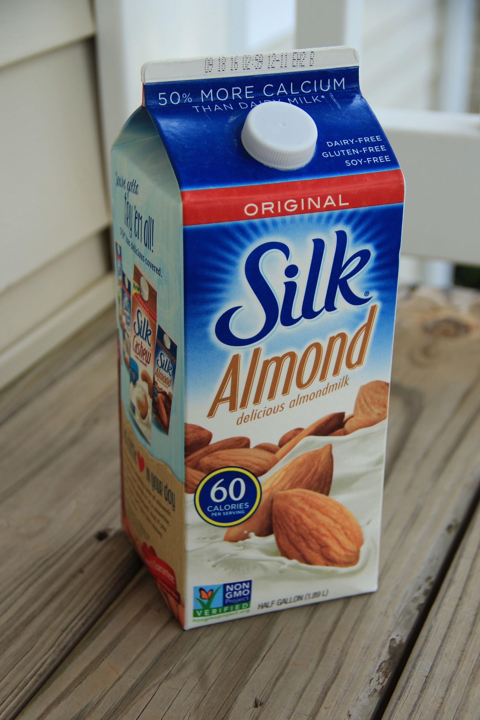
Almond Milk
Maintain strong bones
Regulate blood sugar levels
Maintain good health health and blood pressure levels

Slide 12
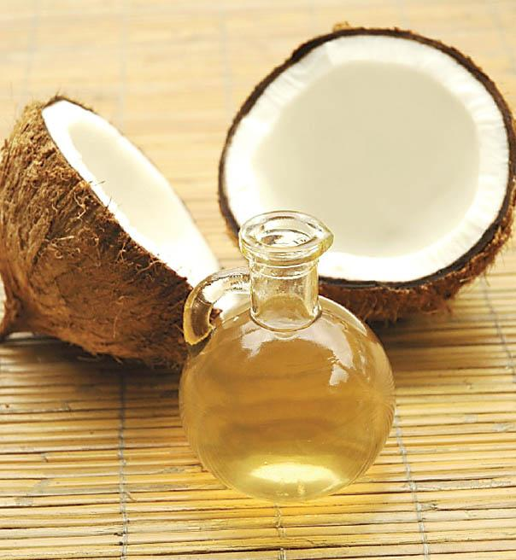
Coconut Oil
A possible reduction in seizure activity
Increased energy
Therapeutic impact for some brain disorders

Slide 13
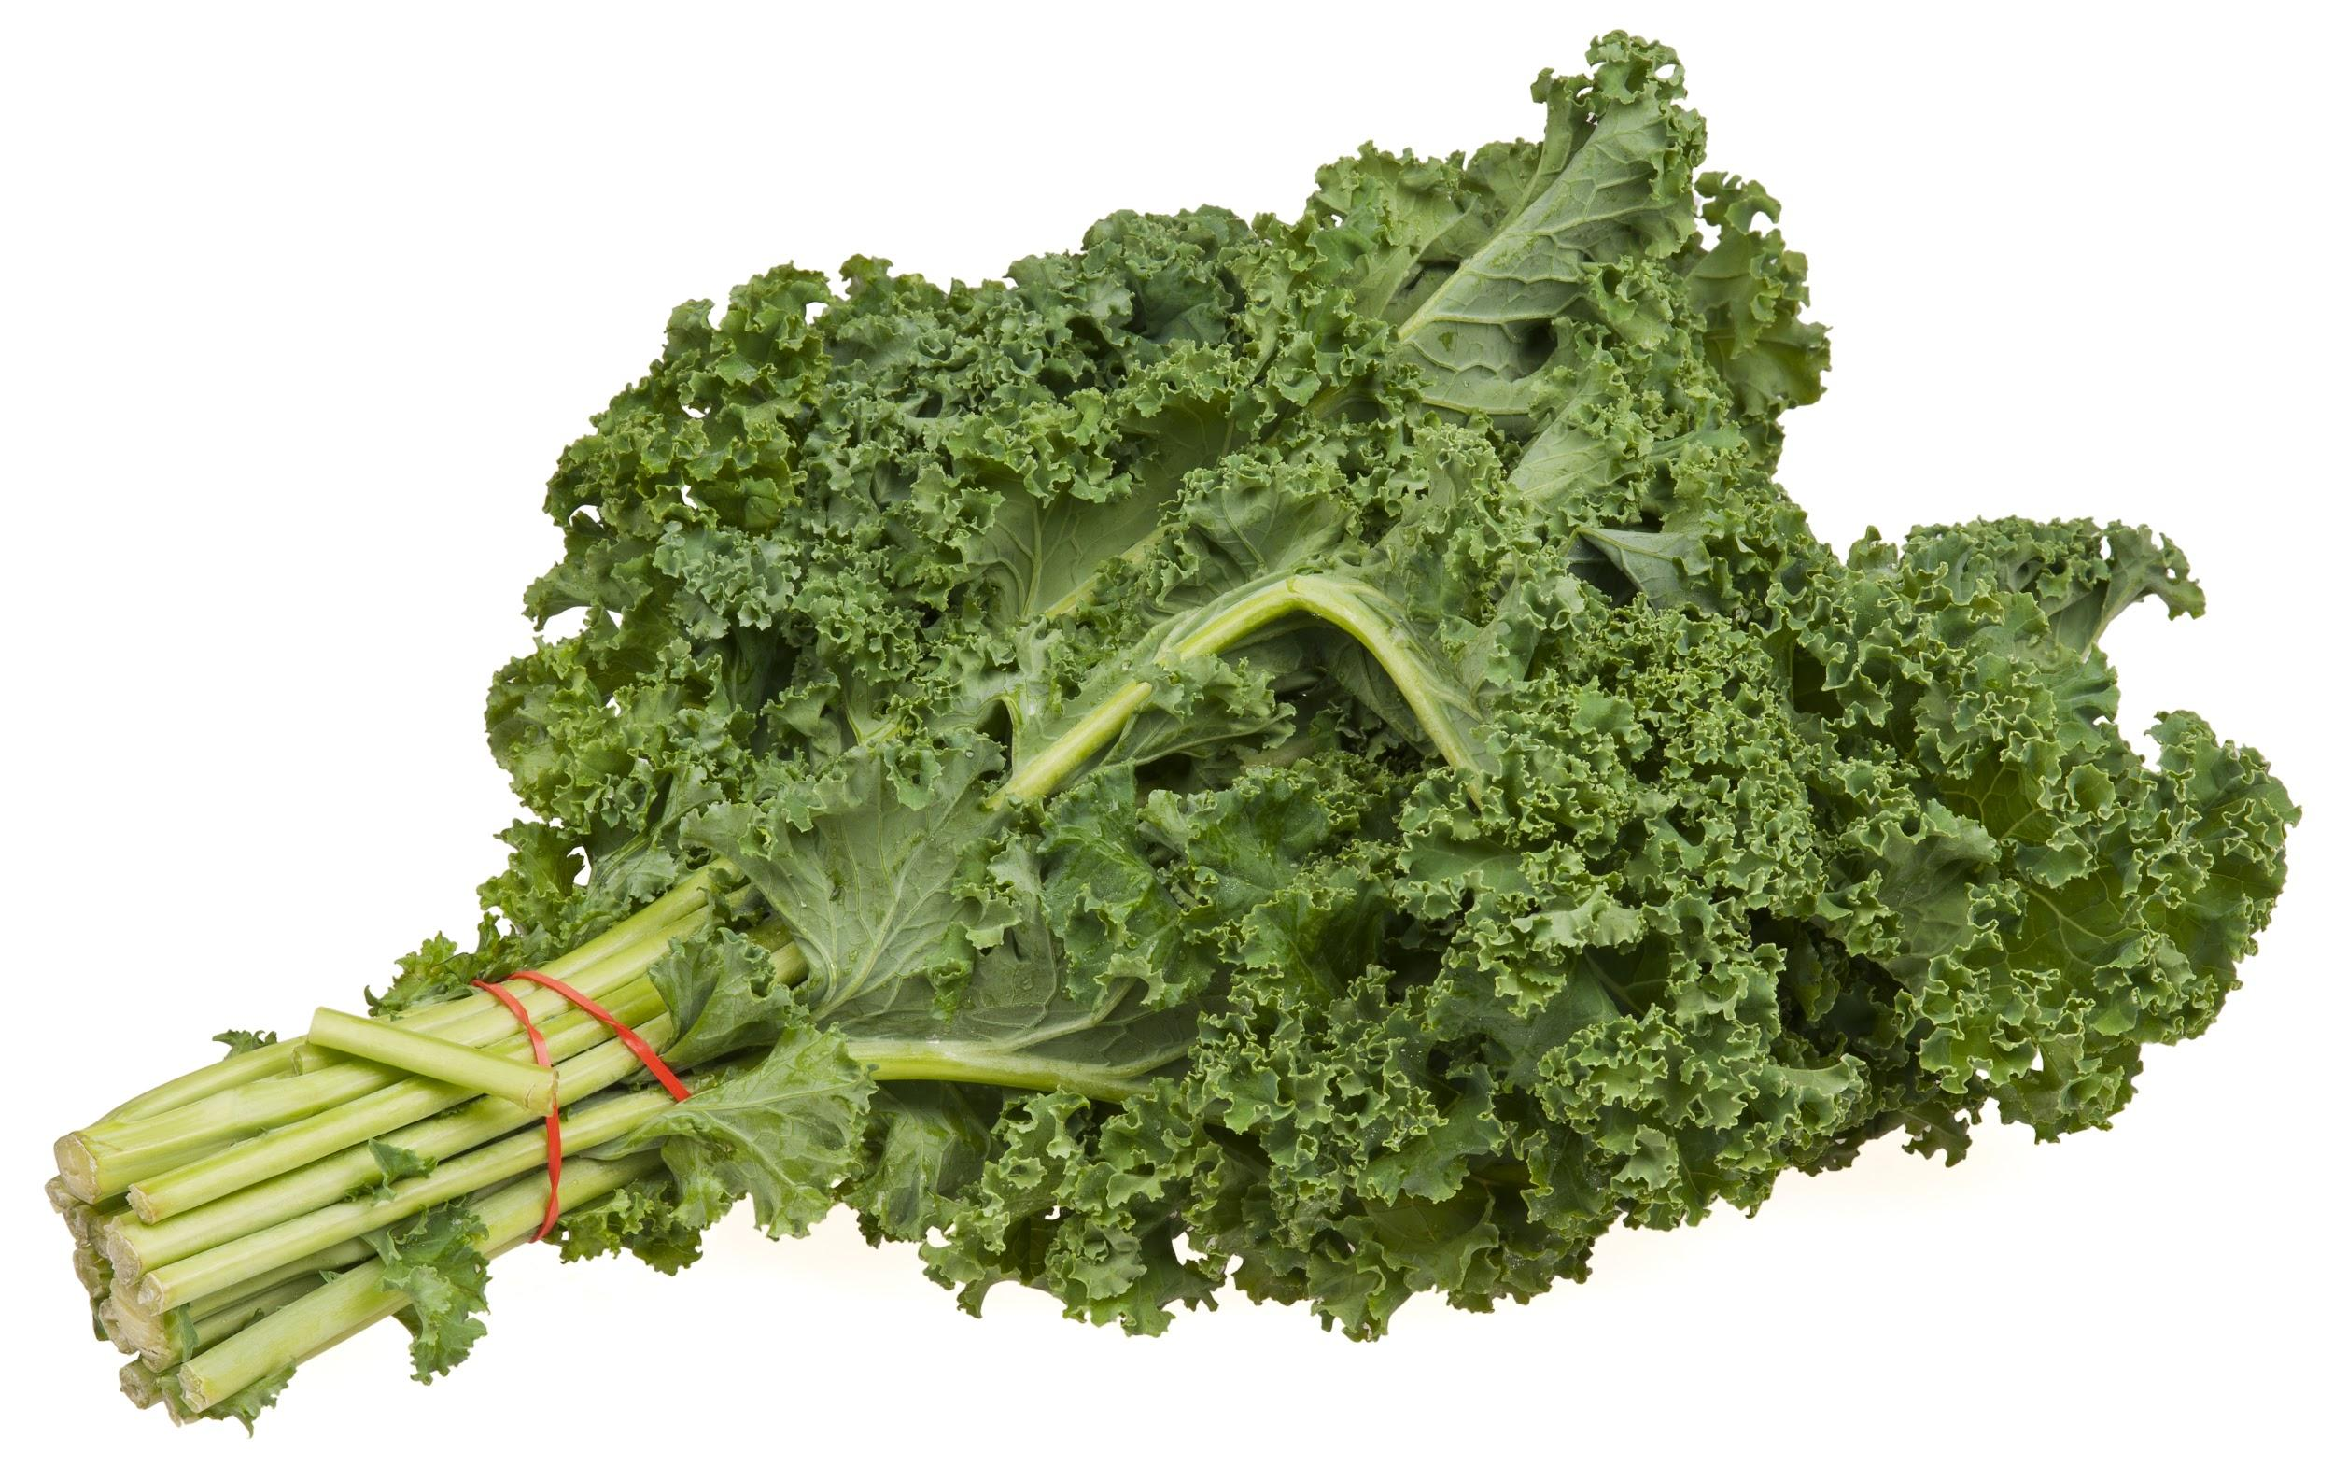
Kale
Promotion of cell growth from Vitamin A
Increased scalp circulation that boosts hair growth
Reduced bloating

Slide 14
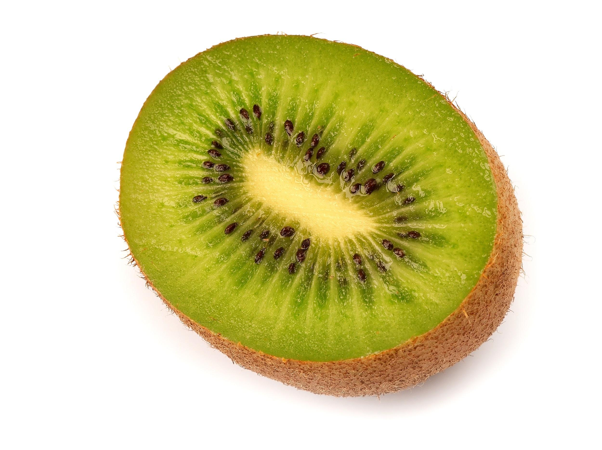
Kiwi
Removal of toxins from the body
Reduced intestinal issues or constipation

Slide 15

Honey
The treatment of indigestion or acid reflux
Use as an antibacterial to fight off viruses
A boost to immune system processes

Slide 16
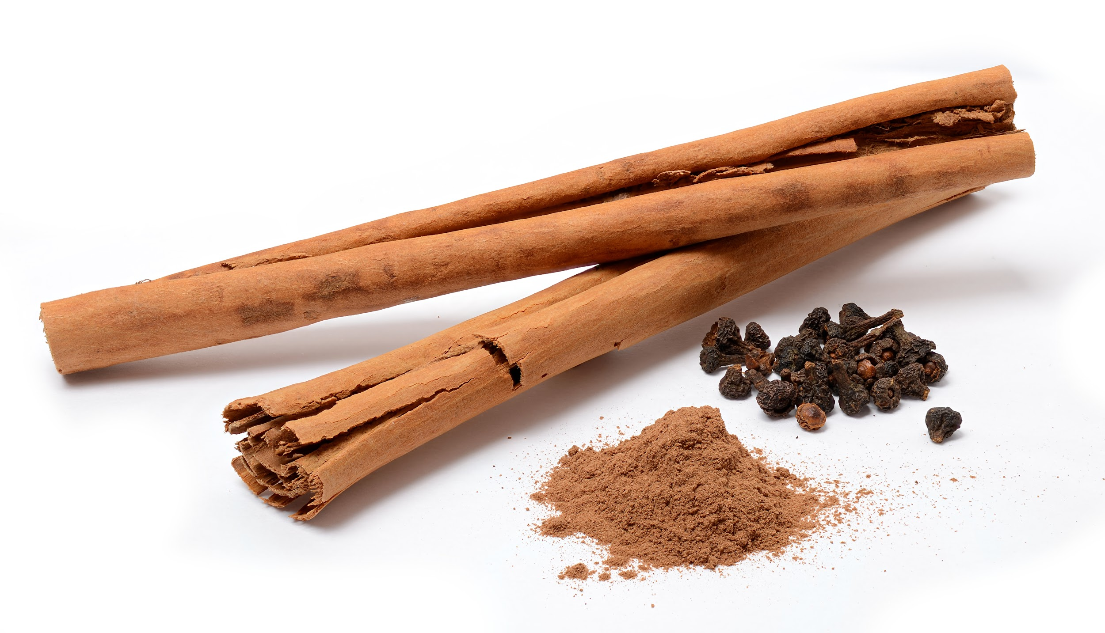
Cinnamon
Helps relieve pain and stiffness in muscles and joints
Can improve memory and attention
Reduces inflammation in blood vessels that leads to heart disease
Helps stabilize blood sugar levels

Slide 17
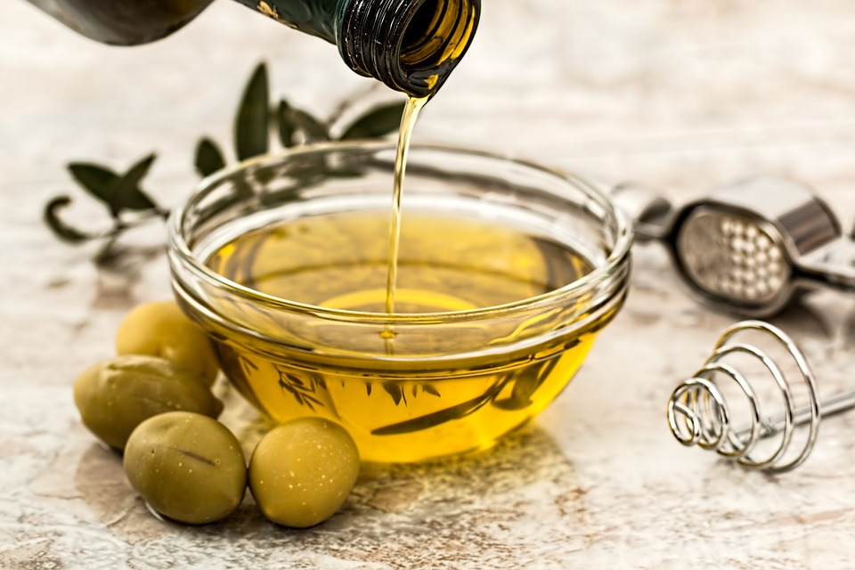
Olives
Contains heart healthy monounsaturated fat
Highest amount of Vitamin E (antioxidant)

Slide 18
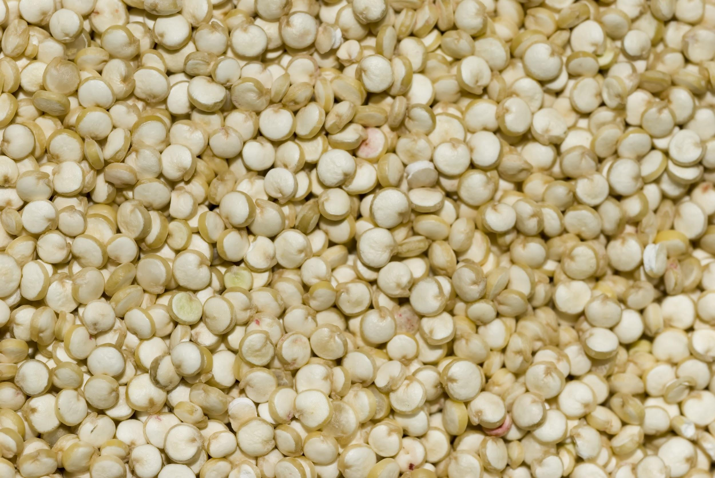
Quinoa
Contains twice as much fiber as other grains (good for digestion)
High levels of iron, protein, magnesium

Slide 19
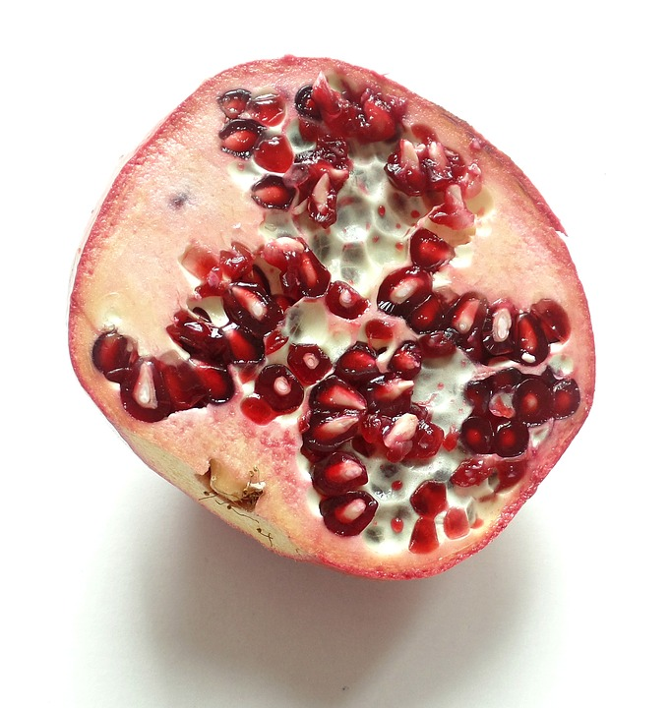
Pomegranate
Effective against heart disease, high blood pressure, inflammation and some cancers, including prostate cancer.
Pomegranate is a good source of fiber. It also contains vitamins A, C and E, iron, and other antioxidants.

Slide 20
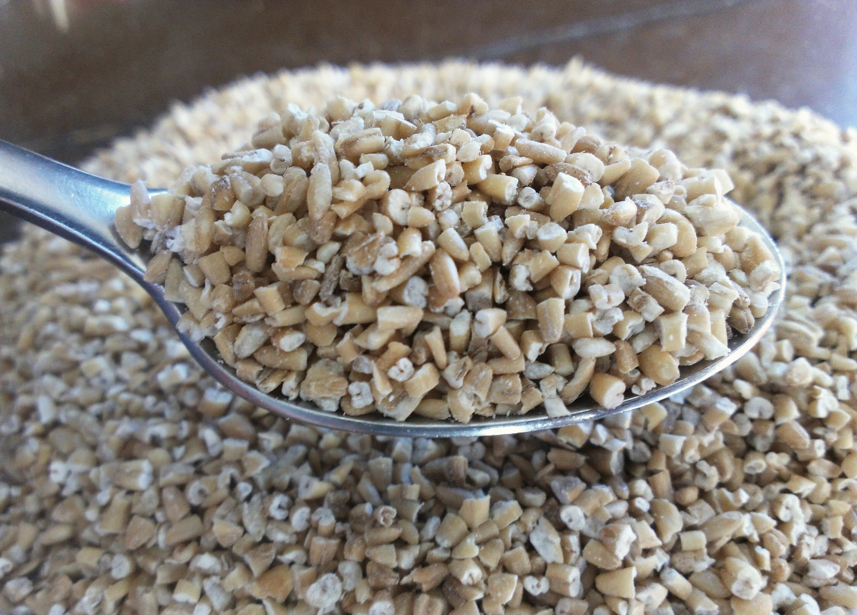
Steel Cut Oats
Lowers LDL and overall cholesterol level

Slide 21
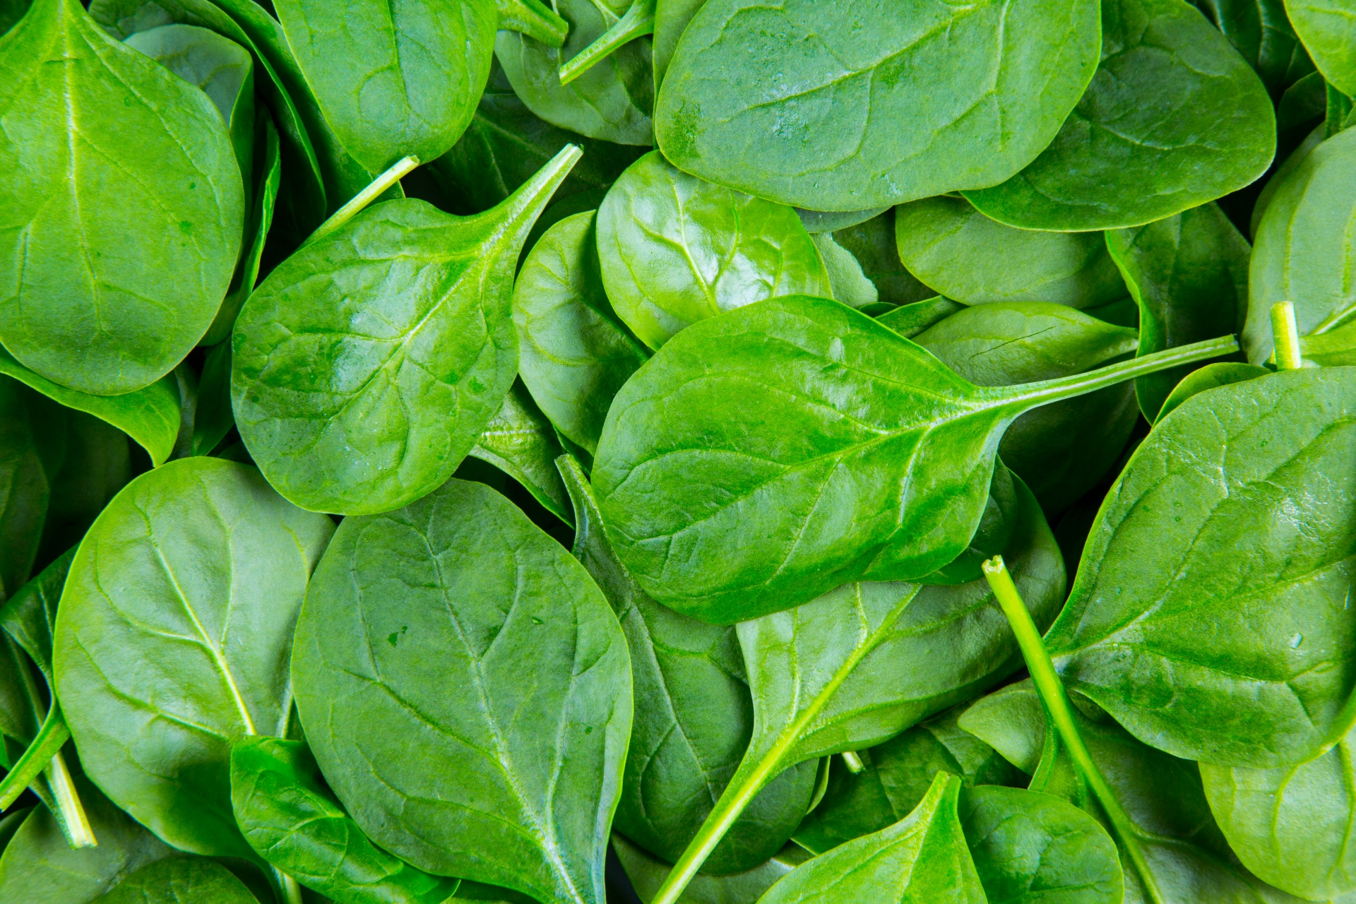
Spinach
Provides more than five times your daily dose of vitamin K, which helps blood clot, and builds strong bones

Slide 22
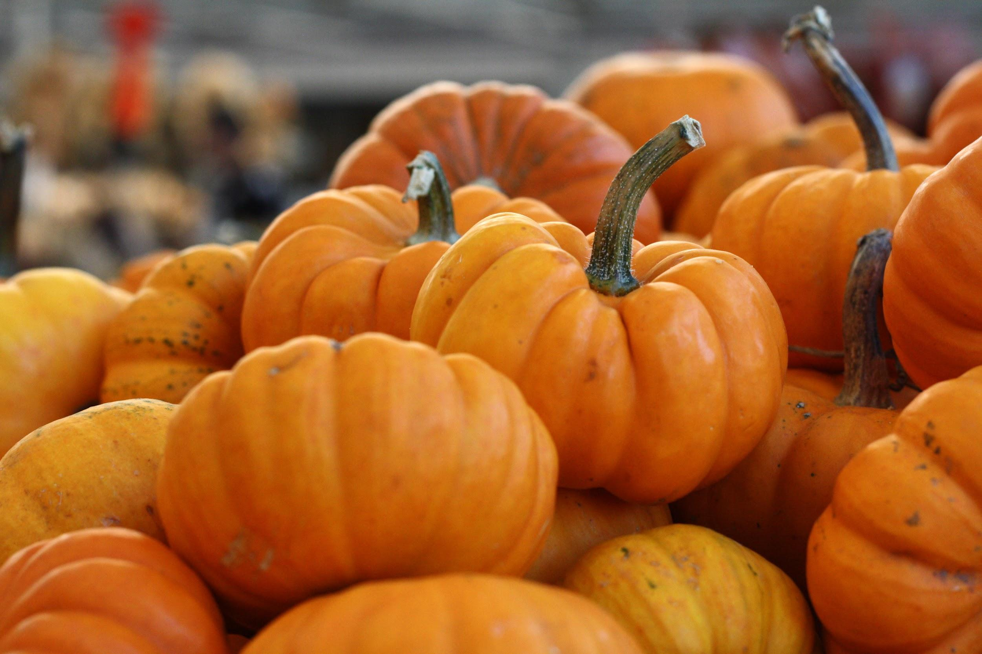
Pumpkin
Filled with natural cancer fighters (alpha and beta carotene)

Slide 23
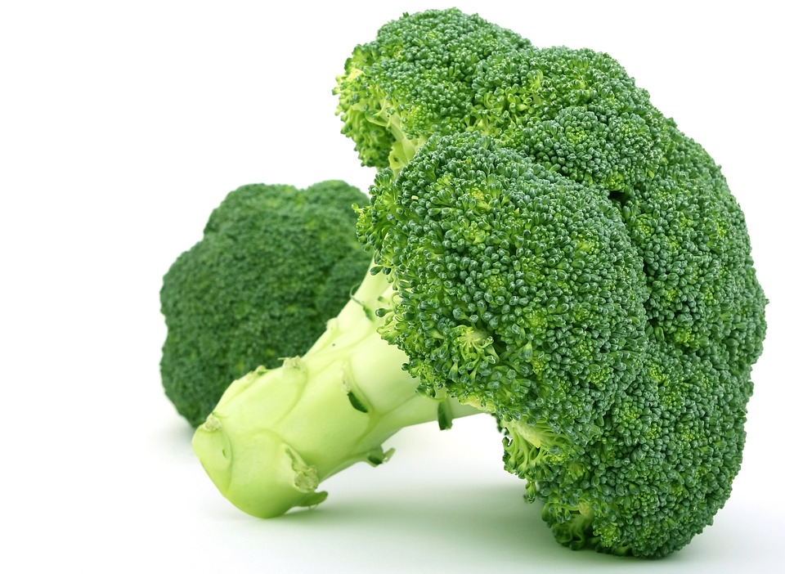
Broccoli
Can help combat cancer, high blood pressure, cardiovascular disease and diabetes

Slide 24
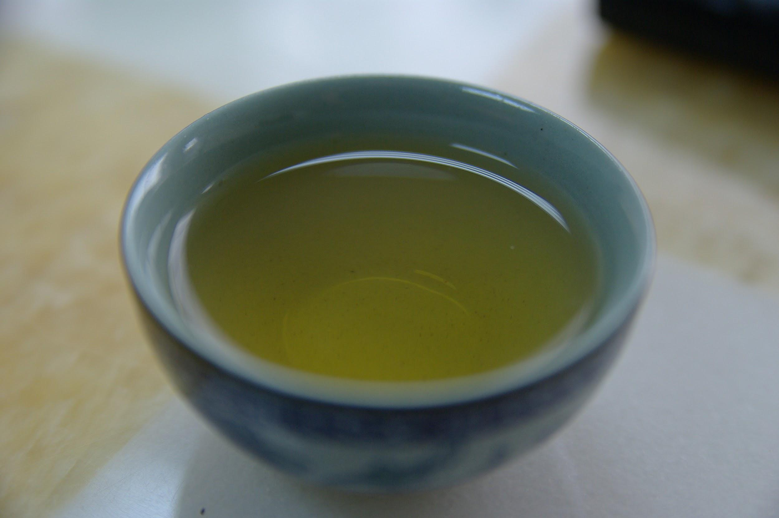
Green Tea
Catechins reduce the size of tumors, and they may even cause cancer cells to die instead of allowing them to grow and spread.
The combination of catechins and powerful antioxidants found in green tea work together to help your body fight fat and burn more calories.

Slide 25
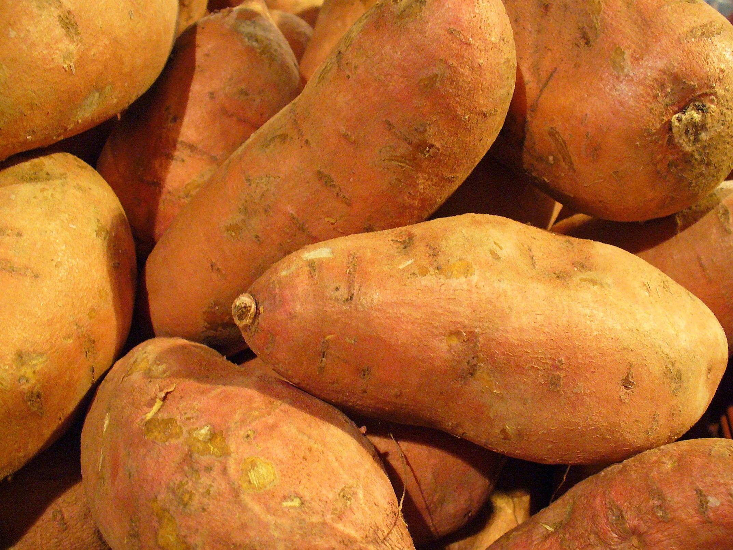
Sweet Potato
Good sources of the anti-inflammatory nutrients, vitamins A and C, making them an excellent food choice for those suffering from arthritis or asthma.
People with diabetes may also benefit from eating this root vegetable because it ranks low on the glycemic index and has less of an effect on blood glucose levels.

Slide 26
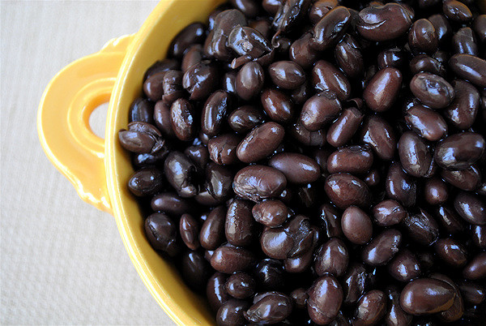
Black Beans
Loaded with protein, fiber, and flavonoids (antioxidants that help your arteries stay relaxed and pliable)

Slide 27
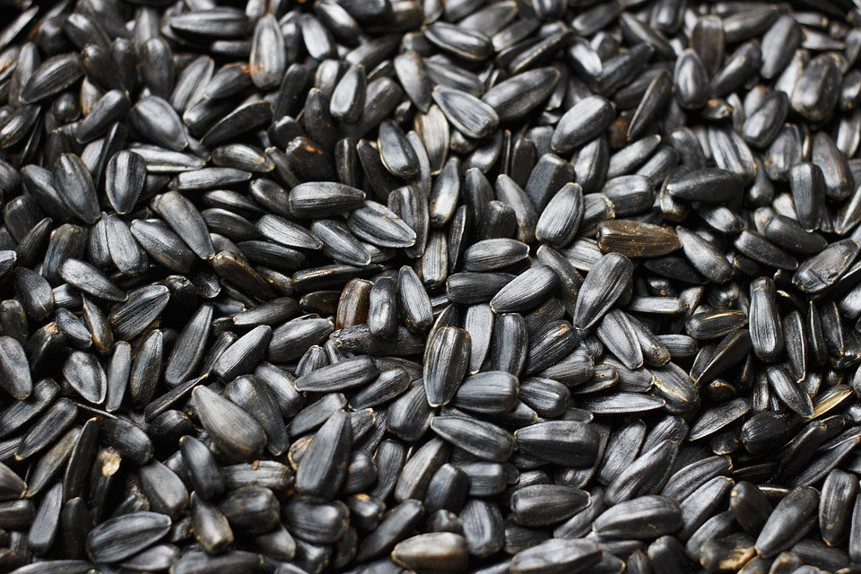
Sunflower Seeds
Quarter cup delivers half your day’s vitamin E, which keeps your heart healthy and fights infection

